Slide 1
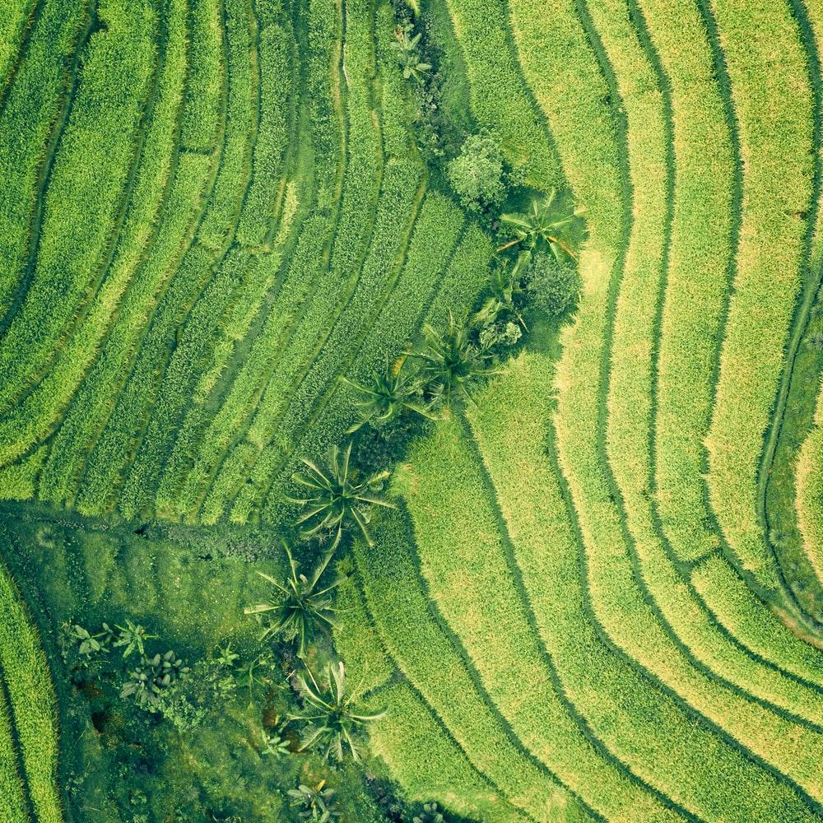
THE LAND WE USE
THE FOOD WE PRODUCE

Slide 2
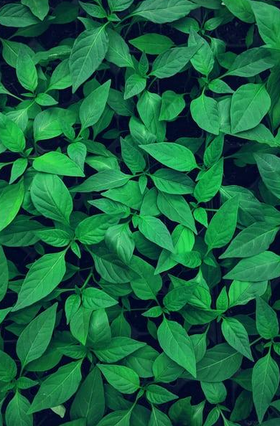
Sustainable agriculture is not just about growing crops, it's about caring for the soil, the water, the air, and all the living things that depend on them.
Vandana Shiva,an Indian scholar, environmental activist, food sovereignty advocate, ecofeminist and anti-globalization author.
Notes:
I decided to look at the topic on how we use the land, particularly crops and forest land.

Slide 3
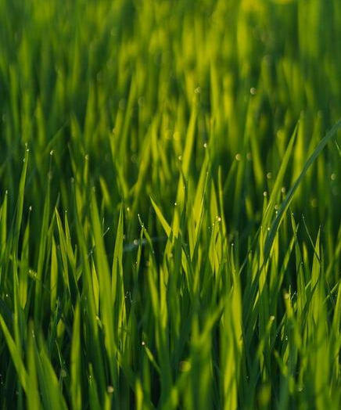
Introduction
Agriculture both contributes to climate change and is most affected by climate change.
The global human population reached 8.0 billion in mid-November 2022 from an estimated 2.5 billion people in 1950, adding 1 billion people since 2010 and 2 billion since 1998.
A disconnected public perspective of agriculture and demographic changes.
Notes:
It the topic that contributes and most affected by climate change.
I think we don’t fully understand the value of land, how we use it and food we produce. Its very big, important topic. I also think and it was hard actually to approach this topic kind of in isolation to other important factors, like politics and its affect on land and food. Economy, population increase, food production, food waist, laws we have on land and food etc

Slide 4
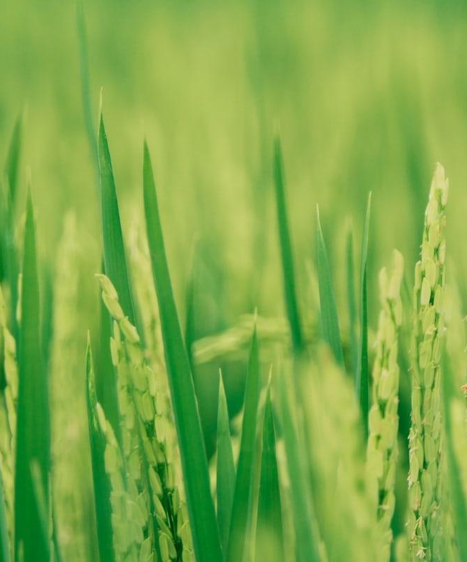
Dataset Overview
Two datasets from FAOSTAT
Data for each country from 2000-2022
# Land used(132,558 rows, 16 columns)
240 countries
#Crops products(246,683 rows, 7 columns)
240 countries
Notes:
This data sets were obtained from Food and Agriculture Organisation of United Nations. The data in this this dataset is very granular, by providing data on 240 countries. Its also had different value measurements, like ha, %, ha value by 1000.
The items listed for both datasets are also very granular, it have 170 different types of grains for example.
Both datasets were processed in VScode
Preprocessing for two datasets:
Created new column and divided countries by 7 regions(leaning toward geographical location of the countries)
Deleting rows with values that wasn’t going to be used

Slide 5

OBJECTIVES
How land is used in agricultural sector
What happening to the forest
What ten countries use cropland the most
What main crop is produced globally
Notes:
First i wanted to llook what land is used for agriculture. What type of land. As not very agricultural person, it was a discovery for me how land is classified.
Im also interested in problem of the forest and whats happening to it. Im originally from Latvia and we have a lot of forest. The landscape of Spain there i currently living is completely different to what ive seen during my childhood.
When investigating the data i wanted to see which countries are dominating in the cropland.
And what main crops is produced on this land.

Slide 6
ANALYSIS

Slide 7
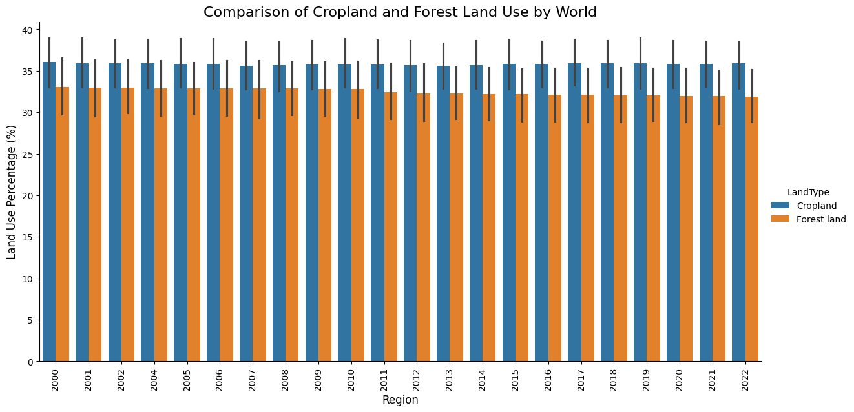
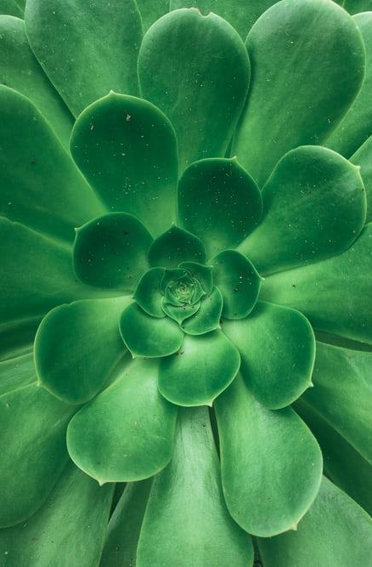
Notes:
First, i wanted to look at cropland and forest areas distributed globally.
As we can see that cropland used globally is a little bit declining. As we know, the talk about climate change been especially ‘popular’ in past 2 decades. In most recent years climate change is more pressing issue on political arena. This affecting cropland use globally and resulting in roughly 3% decrease between 2000 and 2022.

Slide 8
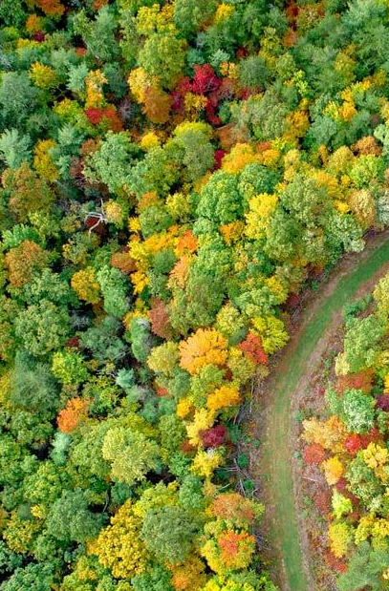
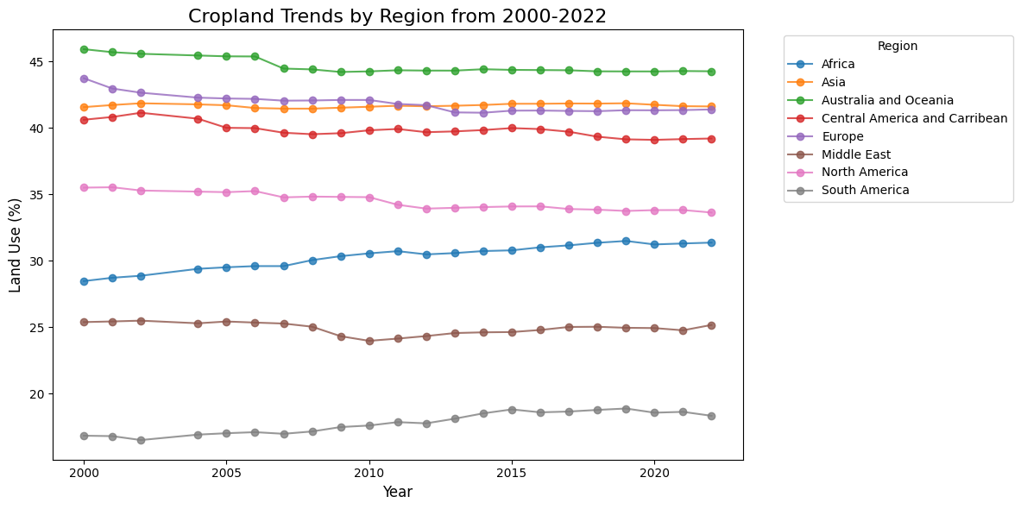
*Cropland= land used for cultivation of crops
Notes:
First, i wanted to look at the cropland used by region between years 2000-2022.
We can see that largest area for cropland is domination by Australia and Oceania by region. It’s been declining over past almost 2 decades by approx 3%.
After that follows Europe and Asia and Central America and caribbean, that have similar percentage of land used by cropland.
Europe, cropland ahve been declinaning over that period also by approx 3%, mostly influenced by EU regulations in recent years due climate change awareness.
In South America cropland usage increased from 11% to 16%

Slide 9
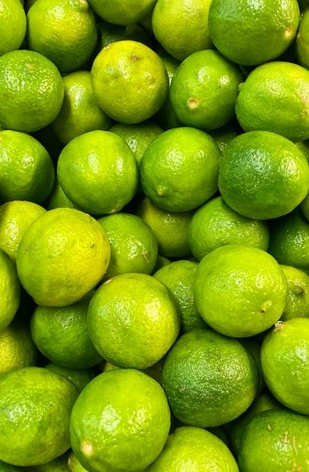
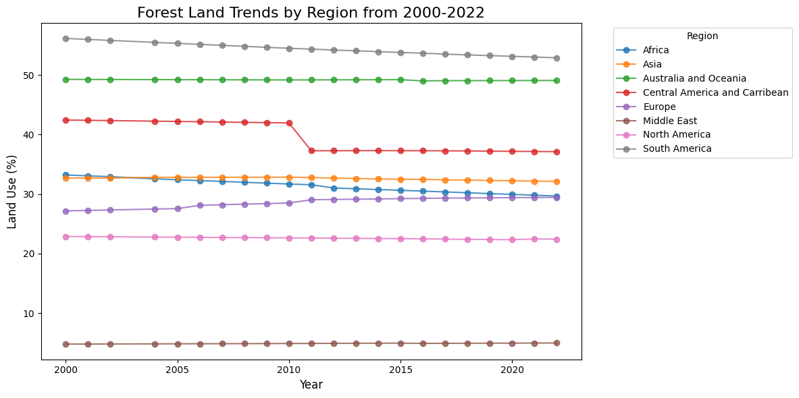
Notes:
Looking over forest land, I can see that forest land keeps declining overal across all regions.
Leading regions who have most of forest land is Africa and Australia and Oceania. The main contribution factor for Australia and Oceania having large forest are is geographical. The are a lot of little countries spread in areas that located on small island and some of then completely covered by forest. I think the logistics factor is playing the role here, as its harder to get machinery and transport the forest from this area.
We also can see dramatic drop in forest land in this area around 2010-2011. Its almost dropped by 10%, which is very significant. I will discuss reasons for this later in this presentation.
Interesting fact, for full regrowth of mature tree its takes 10-20+ years to fully regrow depending on the tree type.
The middle East have most less area covered by forest due geographical location as its mostly deserted area.

Slide 10
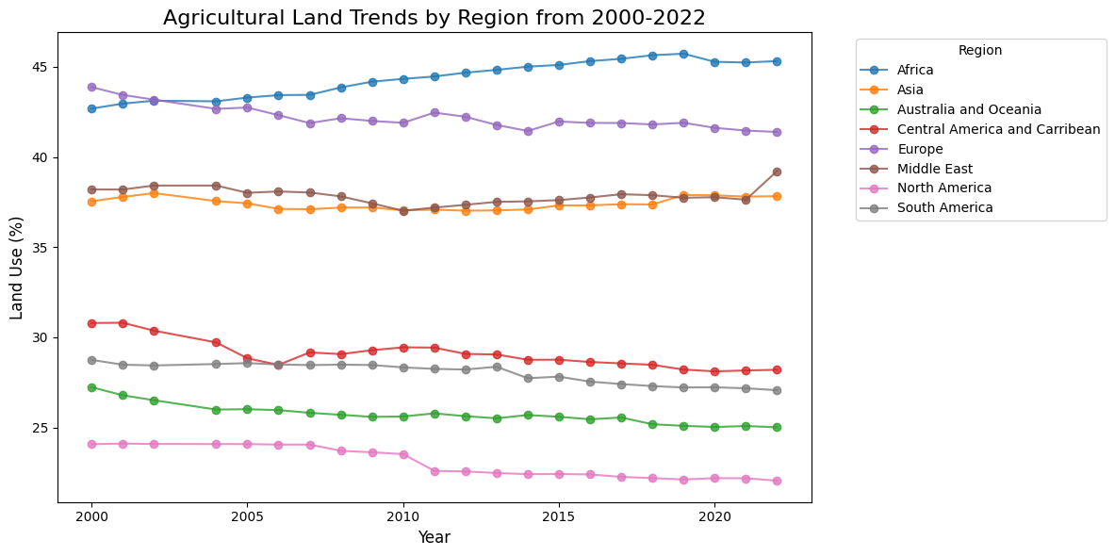
*Land used for cultivation of crops and animal husbandry. The total of areas under ''Cropland'' and ''Permanent meadows and pastures.''
Notes:
Here we can see that agricultural trend dominating by Africa. We can see that this region have quite large are of Agricultural land and its also keeps increasing quite significant. From 42.5% in 2000 to 47% by 2022.
In Europe a lot of land its used for agriculture. Looks like over years its been a rocky trip. Its nice to see its been declining, due EU regulations mentioned before.
Asia and middle east follow up in second place for agricultural land use.
North America been as most least covered by agricultural land and its declining.

Slide 11
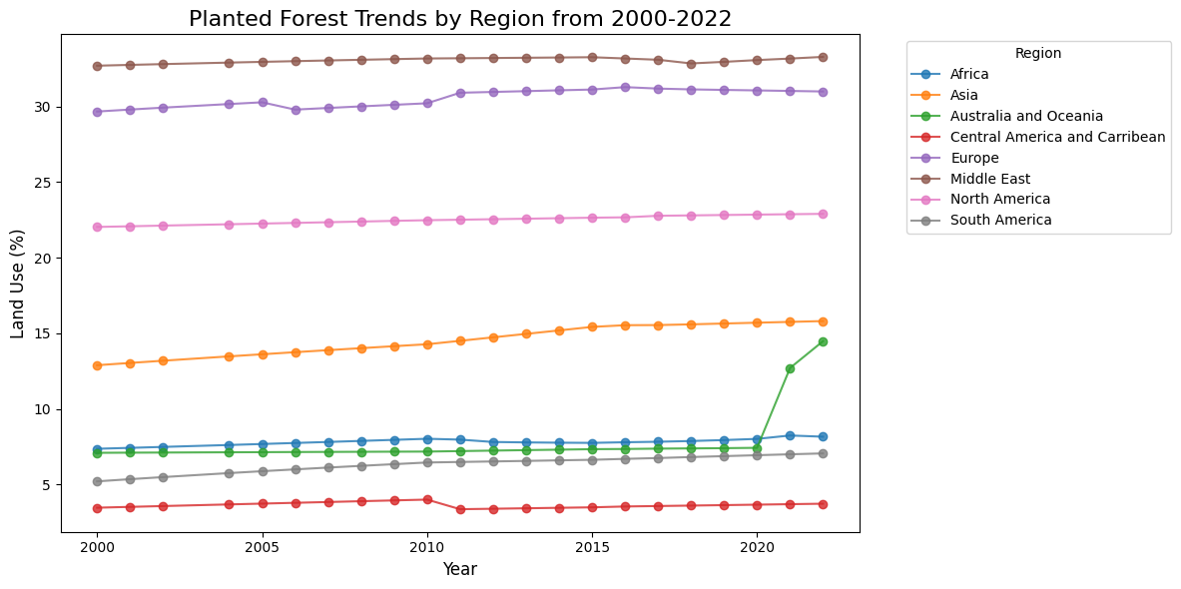
Notes:
I also thought it would be interesting to see planted forest trends.
Its interesting to see that middle east and Europe are leaders in planting forest.
Interesting to see that Australia and Oceanina started to increase planted forest in 202 and its spiked from 7,5% from 2020 to 14% in 2022.
For the rest of the regions there are no major changes.

Slide 12
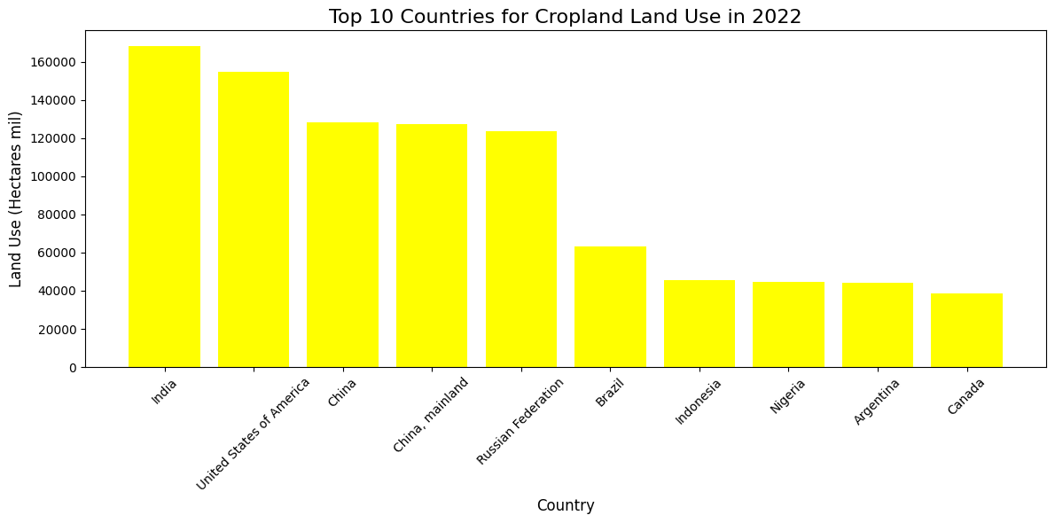
Notes:
Ive also thought it would be interesting to see top 10 Croplnad countries. Its dominating by India, approximately 166 mil ha. Followed by USA with approx 155 mil ha.
Followed by China and Russia at 120 mil ha.
Brazil at over 60 mil ha. Indonesia, Nigeria and Argentina by 45 mil ha and Canada at around 38 mil ha.

Slide 13
We are trashing our land to grow food that no one eats.
Tristram Stuart, and English author and UK Food Waste campaigner

Slide 14
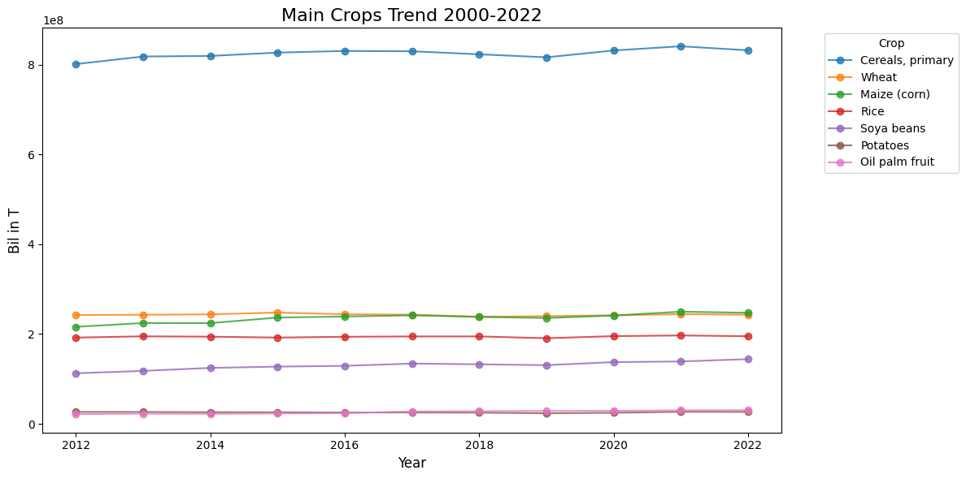
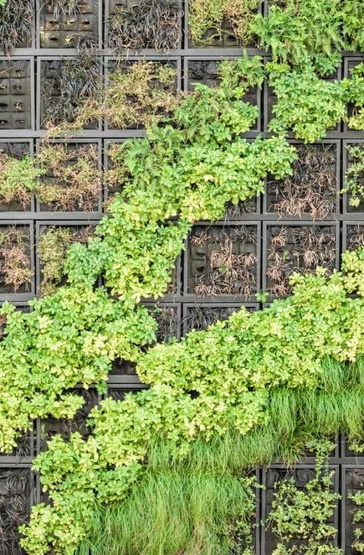
Notes:
I thought it would be interesting to see how we use the land, particularly cropland.
We can see that primary crop is cereal, what is mainly used for production of grains(flour) and animal feed.Globally is produced around 8 billion tones of cereal yearly.
Other main crops include wheat, maize and rice around 2 billion tone a year for each.
Followed by soya beans, at aprox 1,5 bil tones.
Closing by potatoes and oil palm fruit.
Production of oil palm fruit is what affecting forest decline what we seen in previous slides.

Slide 15
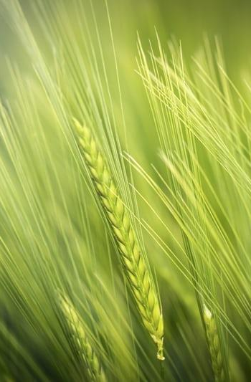



Key takeaway
Declining year by year
Keeps increasing
Main crop - cereal
Notes:
Main discoveries.
Forest land keeps continue to decline globally and cropland keeps increasing. The main crop we produce is cereal.
So mainly we use the cropland to grow food to feed the food.

Slide 16

What’s next?
Notes:
As my background in marketing, from marketing perspective we should approach data from 3 sides:
What data we need
Why we need it
And what we are going to do with it
To answer the last question i have put some suggestions

Slide 17

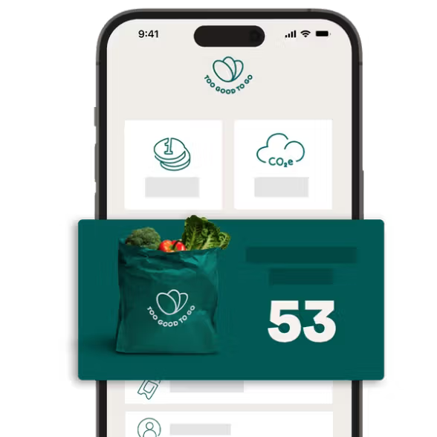
Marketing the problem
Use food what is still good for consumption
Notes:
What we can do?
I think we need to do more marketing for this problem, the problem how we use the land.
If you remember, we have seen that forest land keep decreasing in Australia and Oceania around 2010. We also seen the spike of planted forest in this area around 2020.
Lets have a look what marketing can do to help with this issue.
Too good to go app

